Slide 1
CSC6032 – Advanced Operating Systems
Prof. Yeh-Ching Chung
School of Data Science
Chinese University of Hong Kong, Shenzhen

Slide 2
Outline
Introduction to Distributed Systems
Examples of Distributed Systems
Common Characteristics
Basic Design Issues
Summary

Slide 3
Introduction (1)
A distributed system is the one in which components located at networked computers communicate and coordinate their actions only by passing messages
Systems involve hardware (processors), system software (control) and application and system information (data)
Characteristics of distributed systems
Concurrency of components
Lack of a global ‘clock’
Independent failures of components

Slide 4
Introduction (2)
Centralized System Characteristics
One component with non-autonomous parts
Component shared by users all the time
All resources accessible
Software runs in a single process
Single point of control
Single point of failure

Slide 5
Introduction (3)
Distributed System Characteristics
Multiple autonomous components
Components are not shared by all users
Resources may not be accessible
Software runs in concurrent processes on different processors
Multiple points of control
Multiple points of failure

Slide 6
Introduction (4)
Examples of Distributed Systems
Local Area Network and Intranet
Database Management System
Automatic Teller Machine Network
Internet/World-Wide Web
Mobile and Ubiquitous Computing

Slide 7
Local Area Network

Slide 8
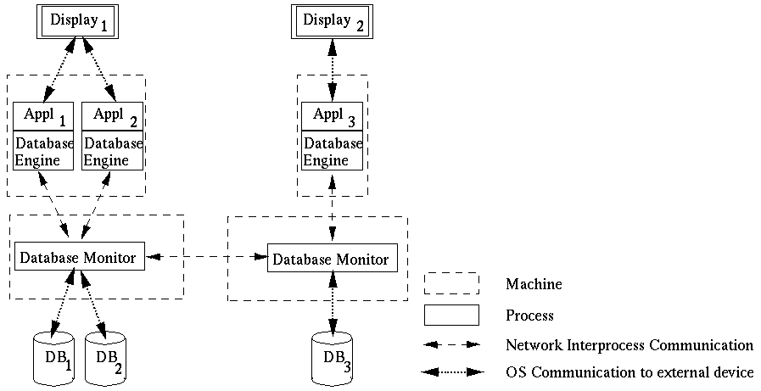
Database Management System

Slide 9
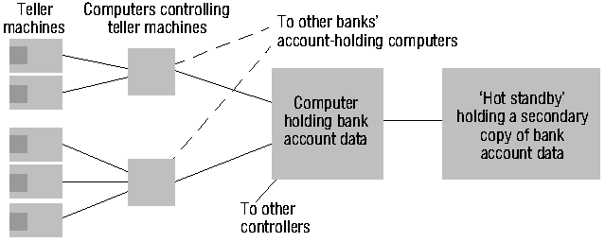
Automatic Teller Machine Network

Slide 10
Internet
intranet
%
ISP
%
%
%
backbone
satellite link
desktop computer:
server:
network link:

Slide 11
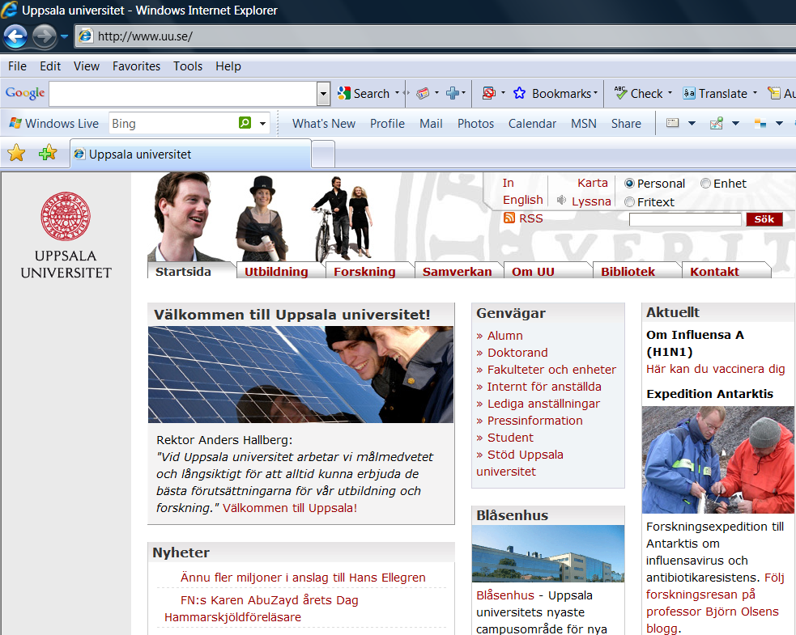
World-Wide-Web

Slide 12
Web Servers and Web Browsers
http://www.google.comlsearch?q=lyu
www.google.com
Web servers
Browsers
www.uu.se
Internet
http://www.uu.se/
www.w3c.org
File system of
http://www.w3c.org/Protocols/Activity.html
www.w3c.org
Protocols
Activity.html

Slide 13
Mobile and Ubiquitous Computing
Internet
Host intranet
GSM/GPRS
Home intranet
Wireless LAN
gateway
Mobile
phone
Printer
Laptop
Camera
Host site

Slide 14
Common Characteristics
Heterogeneity
Openness
Security
Scalability
Failure Handling
Concurrency
Transparency

Slide 15
Heterogeneity
Variety and differences in Networks, Computer hardware, Operating systems, Programming languages, etc.
Middleware as software layers to provide a programming abstraction as well as masking the heterogeneity of the underlying networks, hardware, OS, and programming languages (e.g., CORBA)
Mobile Code to refer to code that can be sent from one computer to another and run at the destination (e.g., Java applets and Java virtual machine)

Slide 16
Openness
Openness is concerned with extensions and improvements of distributed systems.
Detailed interfaces of components need to be published.
New components have to be integrated with existing components.
Differences in data representation of interface types on different processors (of different vendors) have to be resolved.

Slide 17
Security
In a distributed system, clients send requests to access data managed by servers, resources in the networks
Doctors requesting records from hospitals
Users purchase products through electronic commerce
Security is required for
Concealing the contents of messages: security and privacy
Identifying a remote user or other agent correctly (authentication)
New challenges
Denial of service attack
Security of mobile code

Slide 18
Scalability
Adaptation of distributed systems to
Accommodate more users
Respond faster (this is the hard one)
Usually done by adding more and/or faster processors.
Components should not need to be changed when scale of a system increases.
Design components to be scalable!

Slide 19
Failure Handling (Fault Tolerance)
Hardware, software and networks fail
Distributed systems must maintain availability even at low levels of hardware/software/network reliability
Fault tolerance is achieved by
Recovery
Redundancy

Slide 20
Concurrency
Components in distributed systems are executed in concurrent processes.
Components access and update shared resources (e.g. variables, databases, device drivers).
Integrity of the system may be violated if concurrent updates are not coordinated.
Lost updates
Inconsistent analysis

Slide 21
Transparency
Distributed systems should be perceived by users and application programmers as a whole rather than as a collection of cooperating components
Transparency has different aspects
Represent various properties of distributed systems

Slide 22
Access Transparency
Enables local and remote information objects to be accessed using identical operations
File system operations in NFS.
Navigation in the Web.
SQL Queries

Slide 23
Location Transparency
Enables information objects to be accessed without knowledge of their location
File system operations in NFS
Pages in the Web
Tables in distributed databases

Slide 24
Concurrency Transparency
Enables several processes to operate concurrently using shared information objects without interference between them.
NFS
Automatic teller machine network
Database management system

Slide 25
Replication Transparency
Enables multiple instances of information objects to be used to increase reliability and performance without knowledge of the replicas by users or application programs
Distributed DBMS
Mirroring Web Pages

Slide 26
Failure Transparency
Enables the concealment of faults
Allows users and applications to complete their tasks despite the failure of other components
Database Management System

Slide 27
Mobility Transparency
Allows the movement of information objects within a system without affecting the operations of users or application programs
NFS
Web Pages

Slide 28
Performance Transparency
Allows the system to be reconfigured to improve performance as loads vary
Distributed make

Slide 29
Scaling Transparency
Allows the system and applications to expand in scale without change to the system structure or the application algorithms.
World-Wide-Web
Distributed Database

Slide 30
Basic Design Issues
General software engineering principles include rigor and formality, separation of concerns, modularity, abstraction, anticipation of change, …
Specific issues for distributed systems
Naming
Communication
Software structure
System architecture
Workload allocation
Consistency maintenance

Slide 31
Naming
A name is resolved when translated into an interpretable form for resource/object reference.
Communication identifier (IP address + port number)
Name resolution involves several translation steps
Design considerations
Choice of name space for each resource type
Name service to resolve resource names to communication ID
Name services include naming context resolution, hierarchical structure, resource protection

Slide 32
Communication
Separated components communicate with sending processes and receiving processes for data transfer and synchronization.
Message passing: send and receive primitives
Synchronous or blocking
Asynchronous or non-blocking
Abstractions defined: channels, sockets, ports.
Communication patterns: client-server communication (e.g., RPC, function shipping) and group multicast

Slide 33
Software Structure (1)
Layers in centralized computer systems
Applications
Middleware
Operating system
Computer and Network Hardware

Slide 34
Software Structure (2)
Layers and dependencies in distributed systems
Applications
Open
services
Distributed programming support
Open system kernel services
Computer and network hardware

Slide 35
System Architectures
Client-Server
Peer-to-Peer
Services provided by multiple servers
Proxy servers and caches
Mobile code and mobile agents
Network computers
Thin clients and mobile devices

Slide 36
Clients Invoke Individual Servers

Slide 37
Peer-to-Peer Systems

Slide 38
A Service by Multiple Servers

Slide 39
Web Proxy Server

Slide 40
Web Applets

Slide 41
Thin Clients and Compute Servers
Compute server
Network computer or PC
Thin
network
Application
Client
Process

Slide 42
Summary
Definitions of distributed systems and comparisons to centralized systems
The characteristics of distributed systems
The eight forms of transparency
The basic design issues

